Slide 1
Credit Risk Analyzer PREDICTION

Slide 2
PROBLEM STATEMENT
to avoids loss of company money we will check previous consumer loan history to use EDA for the dataset to check which consumer is right to take loan and which consumer is not
When a client applies for a loan, there are four types of decisions that could be taken by the client/company):
Approved: The company has approved the loan application
Cancelled: The client cancelled the application sometime during approval. Either the client changed her/his mind about the loan or in some cases due to a higher risk of the client, he received worse pricing which he did not want.
Refused: The company had rejected the loan (because the client does not meet their requirements etc.).
Unused offer: The loan has been cancelled by the client but at different stages of the process.

Slide 3
Dataset :-
This dataset has 3 files as explained below:
'application_data.csv' contains all the information of the client at the time of application. The data is about whether a client has payment difficulties.
'previous_application.csv' contains information about the client’s previous loan data. It contains the data on whether the previous application had been Approved, Cancelled, Refused or Unused offer.
'columns_description.csv' is data dictionary which describes the meaning of the variables.

Slide 4
Approach
check previous loan history step-by-step to understand consumer data what is actual reason of consumer
use different EDA technics to explore data more and clean it with unused or missing data values
for clear understanding we can use visualizations
to solve problem
I have merge two files i.e. 'application_data.csv’ and 'previous_application.csv’ for solve problem with checking of previous and current data of customer.

Slide 5
EDA
1.DATA SOURCING:use different numpy and pandas function :
Summary In Data Exploring we check first record,last record,shape of dataset,columns present in dataset,missing values count in dataset,information & statistics and check duplicates.
2>DATA CLENING: different numpy and pandas function:
In Data Cleaning we can drop unnecessary columns,fill missing values and change data types of few columns.
3>UNIVARIANT,BIVARIANT,MULTIVARIANT ANLYSIS:use different library like matplotlib or seaborn
Use countplot to check reasons are distributed across different contract status
count plot helps to visualize the distribution of the "TARGET“
allows to quickly understand the relative frequency of each income type in the dataset.
The visualizations offer insights into how the default rate varies across different demographics, including gender, age groups and location.
The numeric variables heatmap helps identify correlations among financial attributes, potentially highlighting factors that contribute to risk

Slide 6
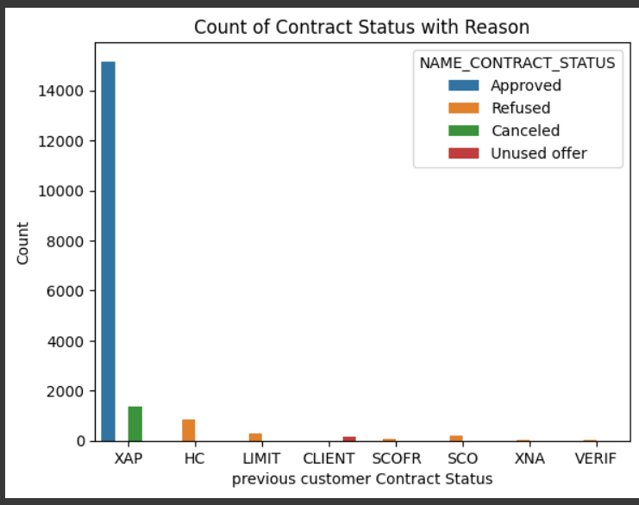
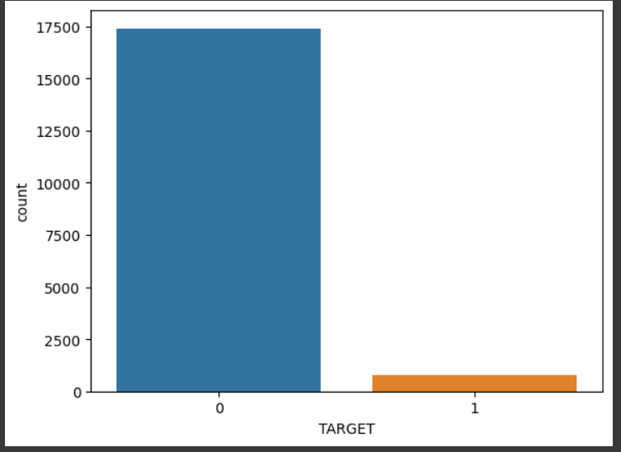
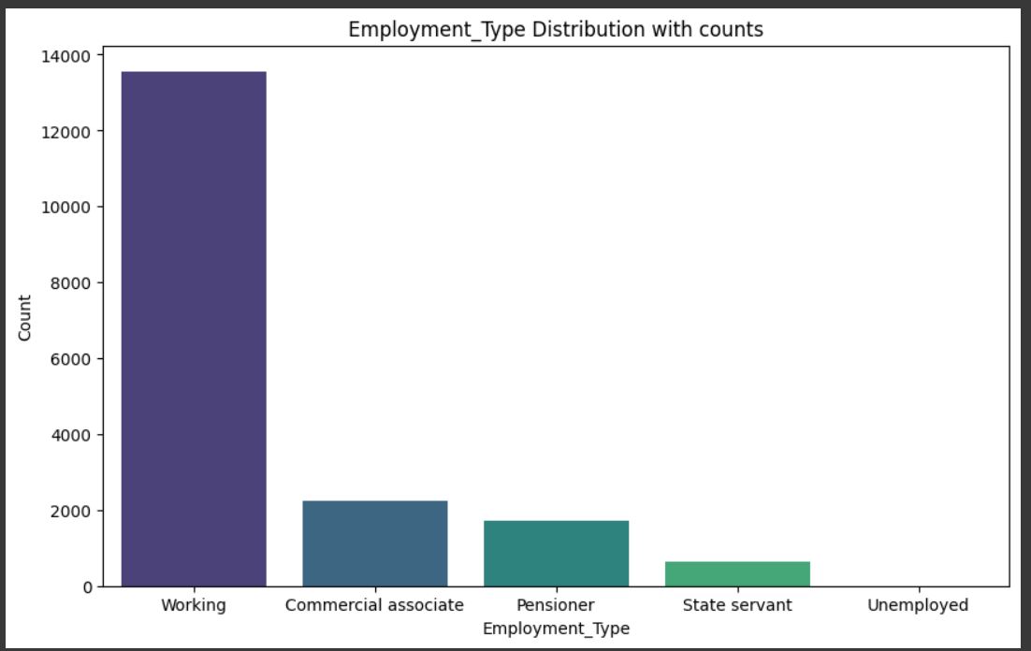
graph
In summary, this EDA provides valuable insights into the relationship between reasons and contract status, aiding in the assessment of consumers who are right to take a loan and those who may pose a higher risk, thus helping to minimize the company's financial loss.
In summary, this initial EDA helps in understanding the distribution of customers with and without payment difficulties, providing insights that can guide loan approval decisions and mitigate the risk of financial loss for the company.
In summary, this EDA provides insights into the distribution of income types among consumers, offering valuable information for making informed decisions about loan approval and minimizing the risk of financial loss for the company.

Slide 7
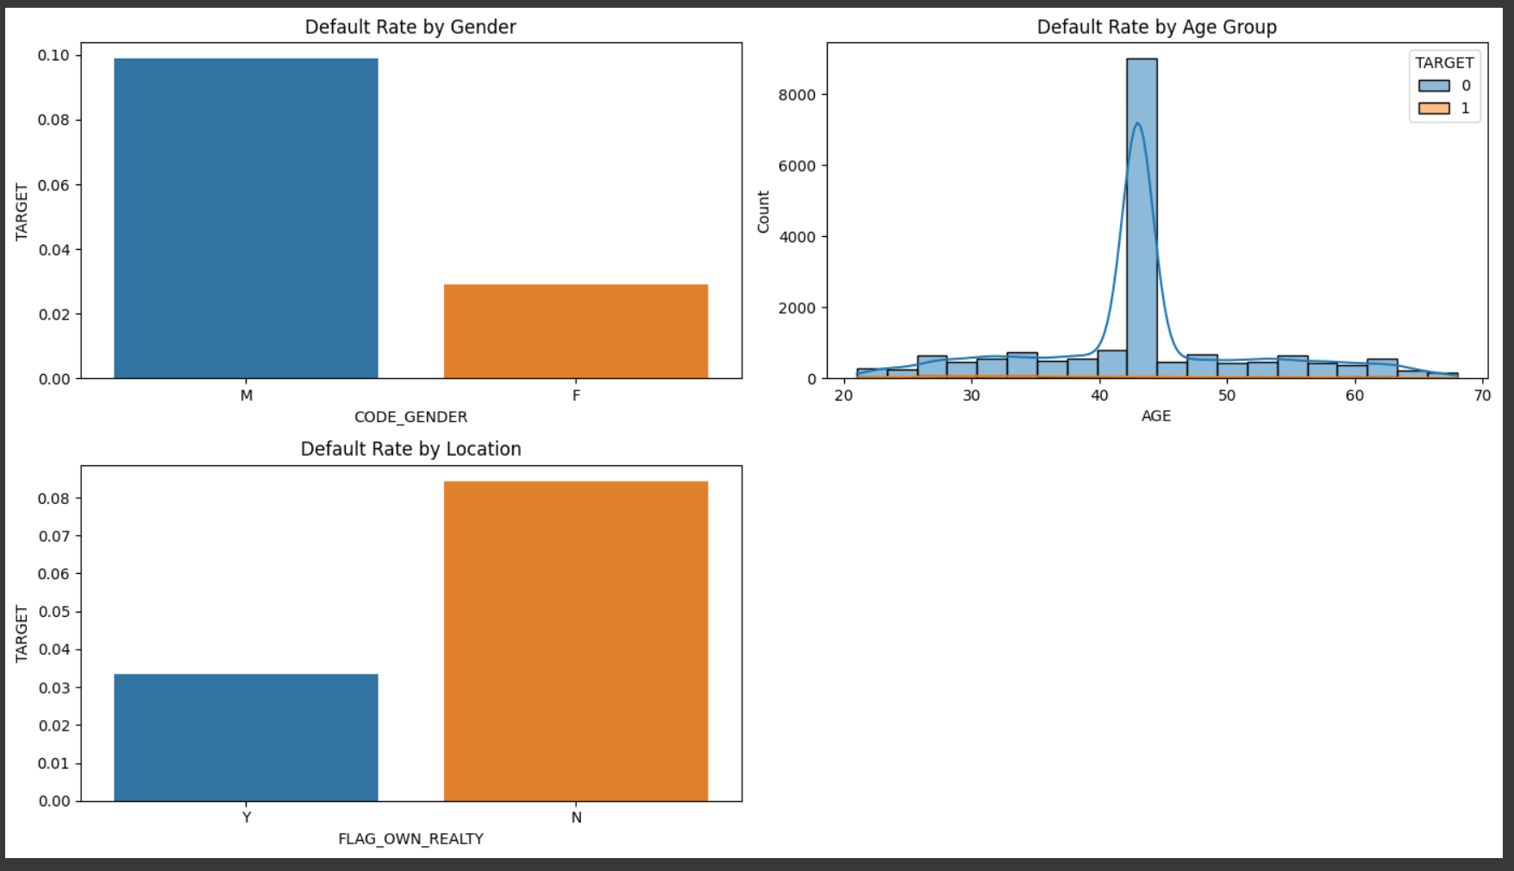
GRAPH
Use the bar plot to observe default rates for different genders.
Utilize the histogram to analyze default rates across different age groups.
Check for variations in default rates between different locations.

Slide 8
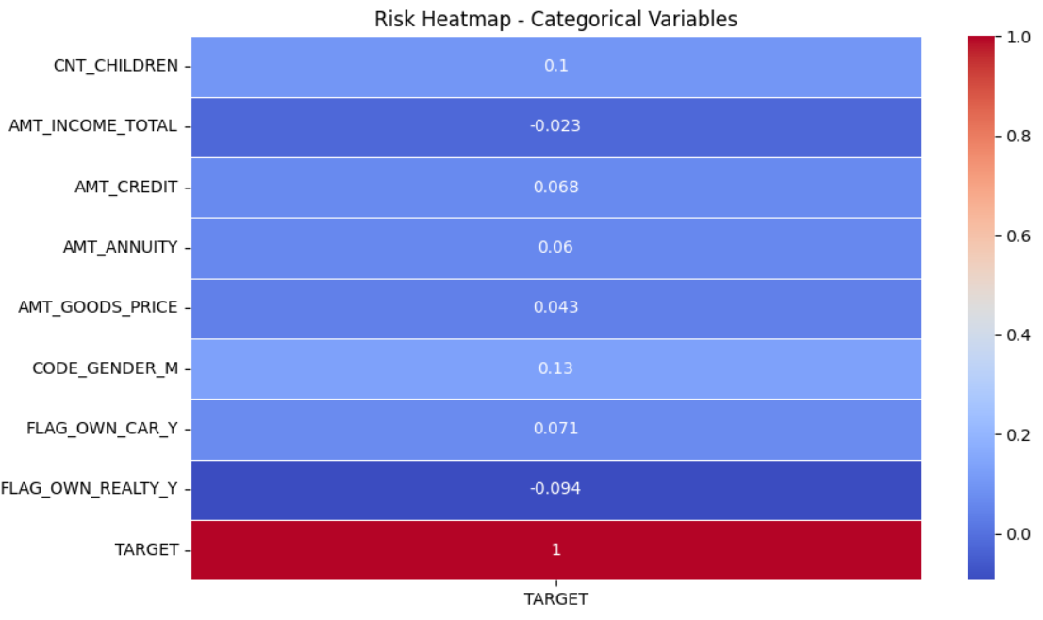
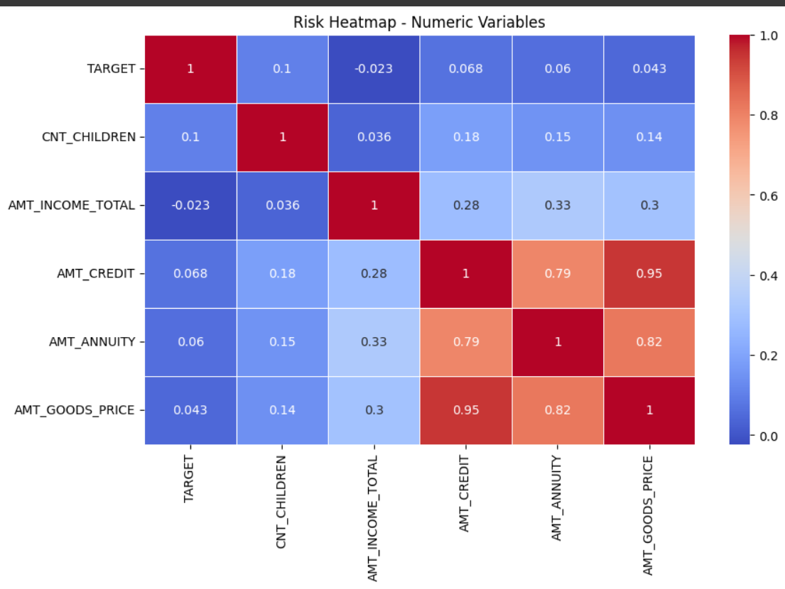
GRAPH
The first heatmap shows correlations among numeric variables, highlighting potential relationships and patterns.
The second heatmap focuses on the correlation between categorical variables (after one-hot encoding) and the target variable.
Correlation values closer to 1 indicate a strong positive correlation, while values closer to -1 indicate a strong negative correlation.

Slide 9
defaulter

Slide 10
THANK YOU!

